Slide 1
10.2 Finding Arc Measure
Essential Question:
How do you find a measure of an arc of a circle?
Standard
7.0: Students prove and use theorems involving the properties of parallel lines cut by a transversal, the properties of quadrilaterals, and the properties of circles.

Slide 2
Terms to know:
Central Angle: An angle whose vertex is the
Center on the circle.
A
Minor Arc: The points on the circle that lie
Within a central angle
B
c
D
Major Arc: The points on the circle that
Don’t lie within a central angle
Semi Circle: An arc with endpoints
That are endpoints of a diameter

Slide 3
Measuring Arcs
A
The measure of a minor arc
is the measure of its central angle
C
B
The measure of the entire
Circle is 360 degrees.
The measure of a major arc is the
Difference between 360 and the measure
Of the related minor arc.
D
The measure of a semicircle is 180 deg.

Slide 4
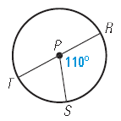
Practice

Slide 5
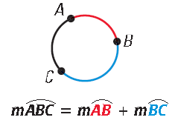
ARC ADDITION POSTULATE
The measure of an arc formed by two adjacent arcs is the sum of the measures of the two arcs.

Slide 6
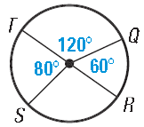
Practice

Slide 7
Terms to Know
Congruent Circles:
Two circles with the
Same radius
Congruent Arcs: Two arcs
With the same measure and
Either on the same circle or
Congruent circles

Slide 8
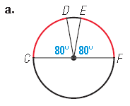
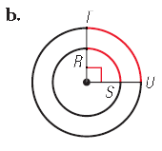
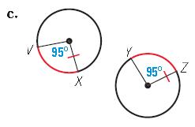
Practice

Slide 9
Practice
In Circle C, $m\hat{AD}= {50}^{o}, B bisects \hat{AD, }and \overline{AE} is a diameter.$
Find the measure of the arc.
$$\hat{AED}$$
$$\hat{BD}$$
C
$$\hat{DE}$$
$$\hat{BAE}$$

Slide 10
Homework:
Page 661-662: 1 – 17 all, 20

