Slide 1
Standards:
7.0 Students prove and use theorems involving the properties of parallel lines cut by a transversal, the properties of
quadrilaterals, and the properties of circles.
21.0 Students prove and solve problems regarding relationships among chords, secants, tangents, inscribed angles, and inscribed and circumscribed polygons of circles.

Slide 2
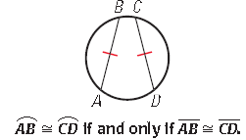
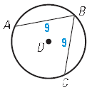
Theorem 10.3:
In the same circle, or in
congruent circles, two
minor arcs are congruent
if and only if their
corresponding chords are
congruent.

Slide 3
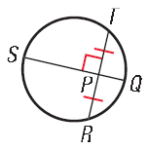
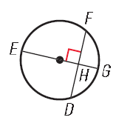
Theorem 10.4:
If one chord is a perpendicular bisector of another chord,
Then the first chord is a diameter.
Theorem 10.5:
If a diameter of a circle is perpendicular to a chord,
Then the diameter bisects the chord and its arc.

Slide 4
Practice:

Slide 5
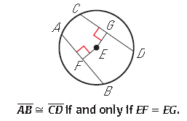
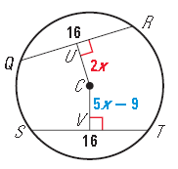
Theorem 10.6:
In the same circle, or in congruent
Circles, two chords are congruent if
And only if they are equidistant from
The center

Slide 6
Practice

Slide 7
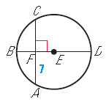
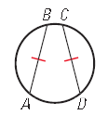
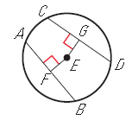
Let’s review…
From the given information in each diagram,
What statement could you conclude?

Slide 8
Homework:
Page 667: #4, 7, 9, 12 – 17 all

