Slide 1
Standards:

Slide 2
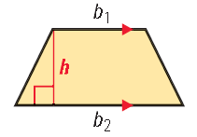
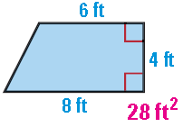
Trapezoids
$$Area= \frac{1}{2}\left(height\right)\left({base}_{1}+ {base}_{2}\right)$$
Be careful…the height is
Perpendicular to the two bases!

Slide 3
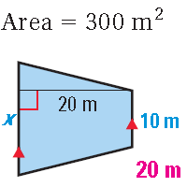
Practice

Slide 4
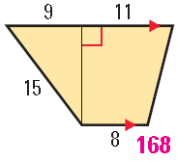
Practice

Slide 5
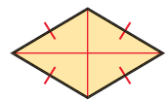
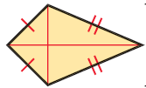
Rhombus and Kite
$$Area= \frac{1}{2}\left({diagonal}_{1}\right)\left({diagonal}_{2}\right)$$
*Diagonals have to be Perpendicular

Slide 6
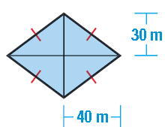
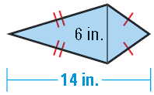
Practice

Slide 7
Homework:
11.1 Page 724: #23, 27
11.2 Page 734: #18, 27, 29

