Slide 1
Essential Questions:
How do you find the length of an arc of a circle
How do you find the area of a sector of a circle
Standards:

Slide 2
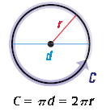
11.4
Circumference of a Circle: Distance around a circle
Circumference = $π\left(diameter\right)$
= $2π\left(radius\right)$
Find the indicated measure.
Circumference of a circle with radius 9 centimeters
Radius of a circle with circumference 26 meters

Slide 3
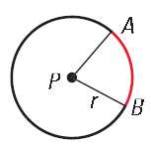
Arc Length

Slide 4
Practice
Find the circumference of the red circle
27

Slide 5
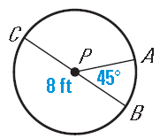
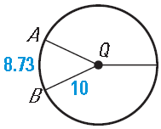
Practice
Find the indicated measure
1. length of arc AB.
2.

Slide 6
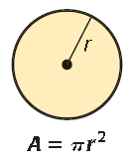
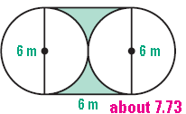
11.5
Area of a Circle:

Slide 7
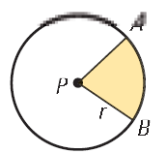
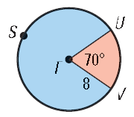
Sector of a Circle:

Slide 8
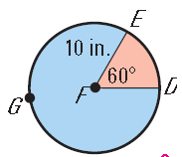
Practice

Slide 9
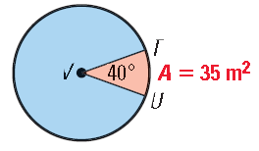
Practice

Slide 10
Homework:
Page 750: #15 – 23all
Page 758: # 12, 13, 14

