Slide 2
How do you prove that two triangles are
Similar by using the SSS and SAS similarity
Theorem?

Slide 7
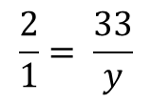
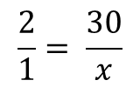
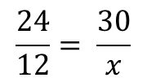
$$\frac{24}{12}= \frac{30}{x}$$
$$\frac{2}{1}= \frac{33}{y}$$
12
$$\frac{2}{1}= \frac{30}{x}$$
y = 16.5
x
y
x= 15

Slide 9
Next, compare the ratios of the lengths of the sides that include < A and < F

Slide 11
HOMEWORK:
Text book
Page 391
# 3, 6, 7, 10, 11, 12, 14, 18 – 23 all.
Have Fun !!!!!

