Slide 1
1. $\overline{EF}$
3. Scale factor
2. $\overline{AC}$

Slide 4
The image P’ is an enlargement
The image P’ is a Reduction.

Slide 5
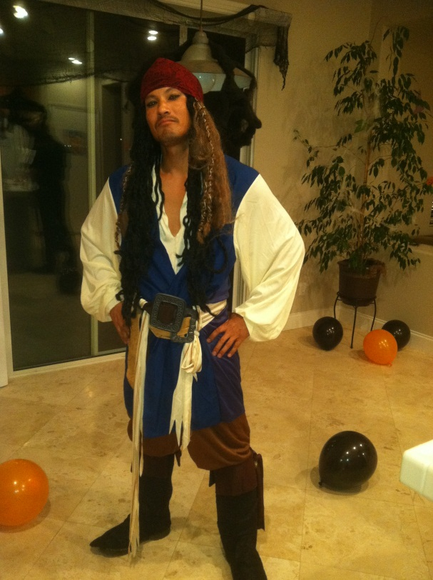
EXTRA Example 1
A’
15
A
6
C

Slide 11
Homework:
Page 629:
# 1 – 6 all, 16, 19, 23, 24

