Slide 1
Comparing Numbers in Scientific Notation
10/21/13
Math 8

Slide 2
Review
Write each number in Scientific Notation
4100
0.000067
34,600,000
$$4.1 × {10}^{3}$$
$$6.7 × {10}^{−5}$$
$$3.46 × {10}^{7}$$

Slide 3
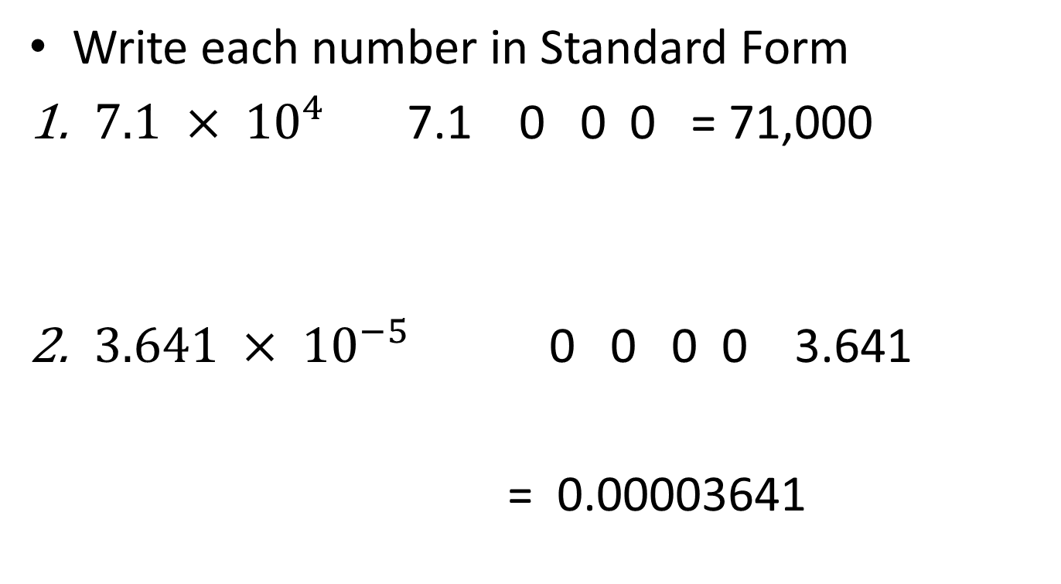
Review
Write each number in Standard Form
$7.1 × {10}^{4}$ 7.1 0 0 0 = 71,000
$3.641 × {10}^{−5}$ 0 0 0 0 3.641
= 0.00003641

Slide 4

Compare
$5.2 × {10}^{5}$ and $9.4 × {10}^{4}$
Look at the exponents on the Base of 10
Power of 5 is greater than Power of 4
Therefore, 5.2 X 10⁵ is greater

Slide 5

Compare
$8.7 × {10}^{9}$ and $8.8 × {10}^{9}$
With the same Power, look at the Coefficients
8.8 > 8.7 sooo… 8.8 X 10⁹ is Greater

Slide 6

Compare
$8.2 × {10}^{−24} and 2.3 × {10}^{3}$
Winner!!!
Positive Exponents are ALWAYS bigger than Negative Exponents

Slide 7

Compare
Biggest…YAY!!
$1.9 × {10}^{−4 }$ and $2.8 ×{10}^{−3}$
When the Powers are Negative, the one CLOSEST to zero is the biggest
-4
-3
0

Slide 8

Compare
Winner, winner,
Chicken dinner!!
635,000 and $8.6 × {10}^{6}$
Hmmmmm…..
Power of 6 is
Greater than
Power of 5
Write 635,000 in Scientific Notation
635,000
= $6.35 × {10}^{5}$

Slide 9

Order from Least to Greatest
$7.8 × {10}^{−3} , 7.9 × {10}^{−5} , and 0.00056$

Slide 10
Classwork:
Page 207: # 40 – 43 all, 48 – 51 all.

