Slide 1
Exponents with Multiplication and Division
9/23/13
Objective:
To multiply and divide Powers

Slide 2
Exponents of 1
If the exponent is 1, then you just have the variable itself
Example:
$$x^{1}=x^{}$$
$$2^{1}=2$$
$${4x}^{}=4^{1}x^{1}$$
We usually don’t write the “1”

Slide 3
Exponent of 0
If the exponent is 0, then the answer is just “1”
Example:
$$y^{0}=1$$
$$5^{0}=1$$
$${\left(2x\right)}^{0}=1$$

Slide 4
Multiplying variables with Exponents
So, how do you multiply this:
$$\left(y^{2}\right)\left(y^{3}\right)$$
The simplest method is to just ADD THE EXPONENTS!!

Slide 5
Practice 1
$$= x^{3+5} y^{5+1}z$$
$$= x^{5}y^{6}z$$

Slide 6

Practice 2
$$2∙4∙x∙y^{1+1}$$
$$=8xy^{2}$$

Slide 7
Practice 3
$$=3∙4∙x^{2+2}∙y^{2}$$
$$=12x^{4}y^{2}$$

Slide 8
Dividing Variables with Exponents
So, how do you do this?
=
= y

Slide 10
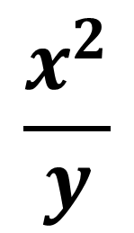
Practice 4
$$\frac{x∙x∙x∙y∙z∙z}{x∙y∙y∙z∙z}$$
$$\frac{x^{2}}{y}$$

Slide 11
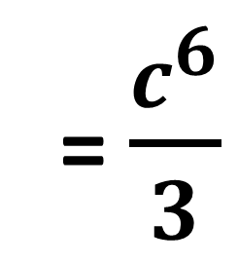
Practice 5
1
$$\frac{7∙c∙c∙c∙c∙c∙c∙c∙c∙c}{21∙c∙c∙c}$$
3
= $\frac{c^{6}}{3}$

Slide 12
Homework
In your TEXT BOOK:
Page 196: 16 – 34 evens, 48, 52

