Slide 1
Graphing Linear Equations using Slope Intercept form
Standard 8 F 2

Slide 2
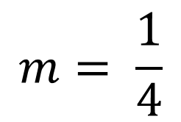
Review
$$b=−1$$
$$m= \frac{1}{4}$$

Slide 3
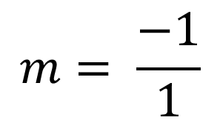
Review
$$b=2$$
$$m= \frac{−1}{1}$$

Slide 4
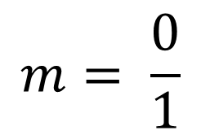
Review
Re-write…
$$y=0x+4$$
$$b=4$$
$$m= \frac{0}{1}$$
Horizontal line
at y = 4

Slide 5
Review
$$m=Undefined$$
It’s a vertical Line
at x = 5

Slide 6
Let’s Practice….
Refer to your Graphing Lines worksheet please

