Slide 1
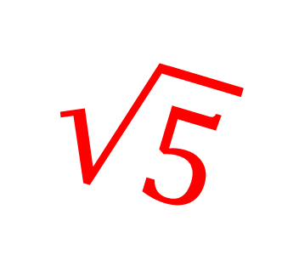
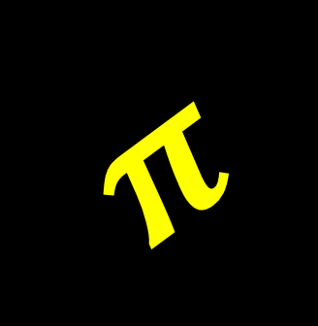
IRRATIONAL NUMBERS
9/24/13
$$π$$
$$\sqrt{5}$$
Objective: To compare and order real numbers
Standard: NS1

Slide 2
IRRATIONAL NUMBERS
An Irrational Number is a real number that
Cannot be written as a simple fraction
Irrational means NOT Rational
An Irrational Number can be written as a decimal, it has endless non-repeating digits to the right of the decimal point.
$$π=3.141592…$$
$$\sqrt{2}=1.414213$$

Slide 6
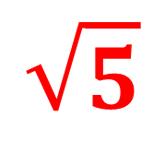
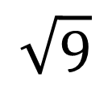
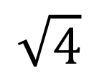
$$\sqrt{5}$$
$$\sqrt{4}$$
$$\sqrt{9}$$
2
2.5
3
$$\sqrt{5} is between 2 and 3…$$
So, 2.1 would be a good guess!

Slide 7
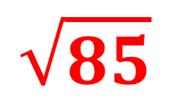
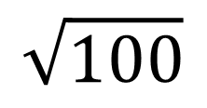
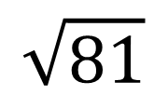
$$\sqrt{85}$$
$$\sqrt{81}$$
$$\sqrt{100}$$
9
9.5
10
$$\sqrt{85} is between 9 and 10…$$
So, 9.3 would be a good guess!

Slide 8
Your Turn…
Is between ______ and ______
Approximate to the nearest tenth…

