Slide 1
Rational Numbers
Objective:
To write fractions as decimals and vice versa.
Standard:
NS1

Slide 2


REAL NUMBERS
Rational Numbers
Irrational Numbers
$$\frac{1}{2} , 3, −14, 7, 1.25, 2\frac{3}{4}, 5.\overline{3}$$
Integers
…,-3, -2, -1, 0, 1, 2, 3,…
$$π$$
Whole
0, 1, 2, 3,…26,…163…
Natural
$$\sqrt{3}$$
1, 2, 3,…57,457,…
And all other
Non-Terminating,
non -Repeating decimals

Slide 3
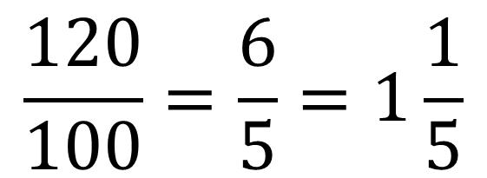

Fractions, Decimals, and Percents
8%
120%
$$\frac{8}{100}= \frac{2}{25}$$
$$\frac{120}{100}=\frac{6}{5}=1\frac{1}{5}$$

Slide 4
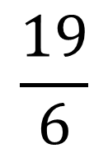
Changing
Fractions to
Decimals
Perform Long Division, Bottom out – Top in.
3
1
6
$$\frac{19}{6}$$
6
19.00
18
1
0
6
4
0
36
4

Slide 5
Changing
Decimals to
Fractions

Slide 6
Changing
Decimals to
Fractions
Continued…

Slide 7
Changing
Decimals to
Fractions
Continued…

Slide 9
Homework: TEXT BOOK
Page 222: #20 – 38 Even, 57

