Slide 1
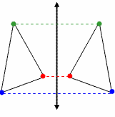
Reflection
Math 8
8/22/13

Slide 2
Reflections are everywhere… in mirrors, glass, pools, lake.
…. What do you notice?
Line of Reflection or Mirror Line

Slide 3
In a Reflection, every point is the same distance
from the line of Reflection
… and …
The Reflection has the
same SHAPE and SIZE
as the original picture
Think of a Reflection as a FLIP

Slide 4
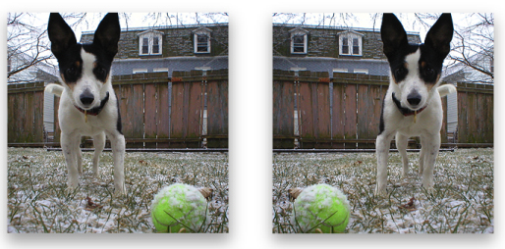
YES!!!

Slide 6
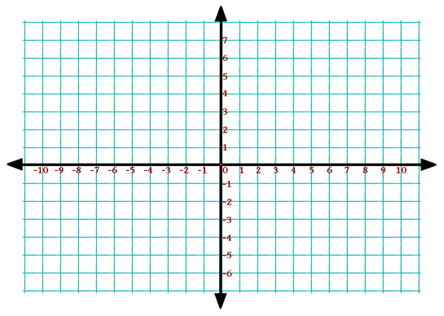
Reflect triangle ABC across the y-axis
C
C’
A
A’
B
B’
Line of Reflection

Slide 7
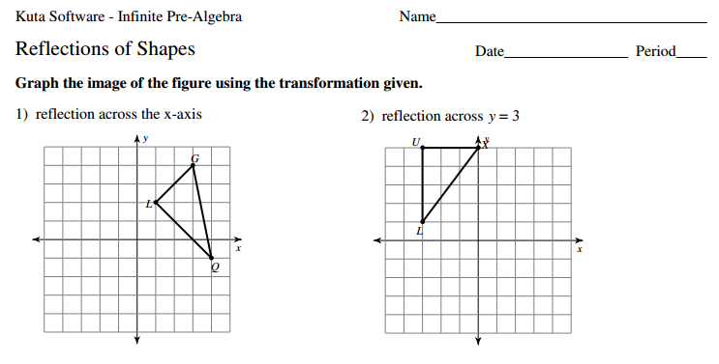
Let’s practice Reflecting….
Look at your Reflection of Shapes worksheet

