Slide 1
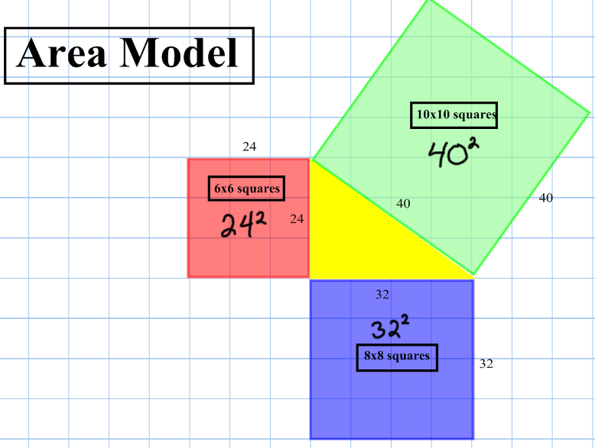
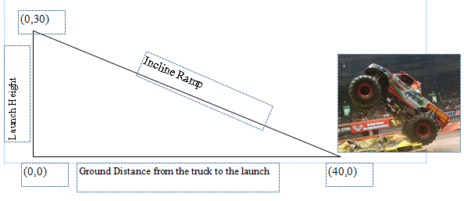
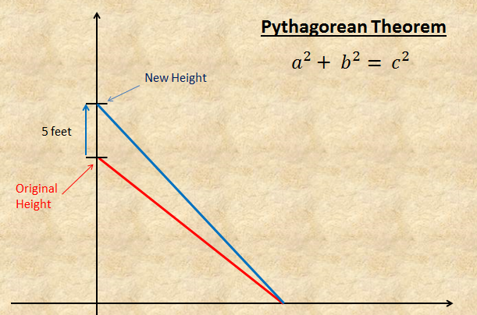
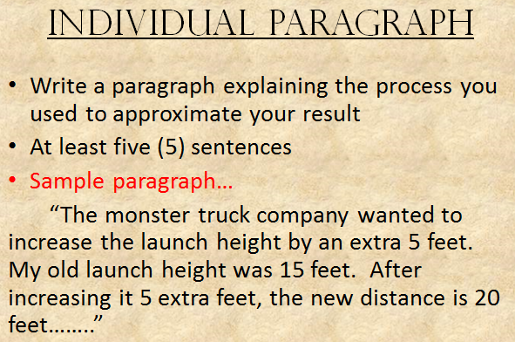
Your tasks…
Task 3
Task 1
Task 2

Slide 2
Task #4
Tuesday. Oct 22, 2013
Math 8

Slide 3
Description of Task #4
Since you did such a great job with the monster trucks, NASA hired you to use the Pythagorean Theorem to calculate the distance from earth of a newly discovered planet that they have named Daffy. Satellites show that Daffy is 9 billion miles east of earth and 12 billion miles north of earth. However, to be consistent with how NASA’s technology was designed, your answer must be in scientific notation.

Slide 4
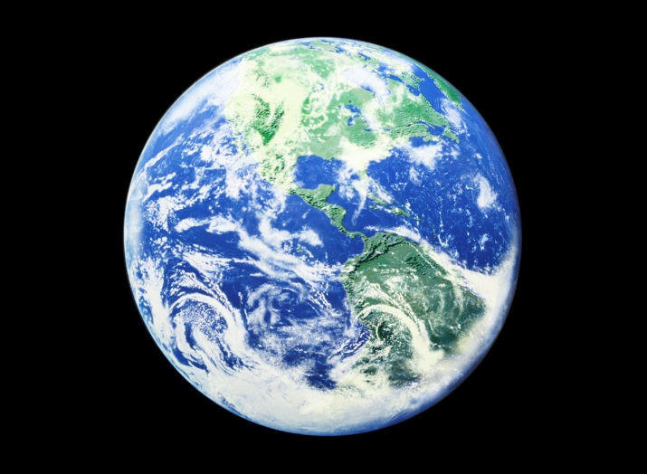
Daffy
How far is Daffy
From Earth
12 billion miles
9 billion miles

Slide 5
Your task…
Working independently, apply the Pythagorean Theorem to determine how far away Daffy is from earth in billions of miles.
Write your answer in Scientific Notation

Slide 6
Your task…
2. In scientific notation, how much farther is Daffy north of Earth than east of Earth.

Slide 7
Your task…
3. While making your calculations, you decide to take out a telescope to see if you can locate Daffy. You are unable to, however, while searching for Daffy you discover a brand new planet that is four times as far away as Daffy. Your task is to calculate the distance of the new planet so you can name it after yourself.

Slide 8

New Planet
How far is your
new planet
From Earth?
12 billion miles X 4 =
Daffy
9 billion miles X 4 =

