Slide 1
Volume of Prisms and Cylinders
Geometry
11/6/13

Slide 2
Volume of a Solid
Is given by
Volume = Area of Base x height
Base could include
A triangle, Square,
Rectangle, Circle, etc

Slide 3
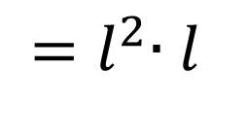
Volume of a Cube Postulate
Volume = Area of Base x height
$$=\left(l×l\right)∙l$$
$${=l}^{2}∙l$$
$$= l^{3}$$
$$V= l^{3}$$
or
$$V= b^{3}$$

Slide 4
Volume of a Right Cylinder
Find the volume of the solid
V = Bh
Area of the Base: $πr^{2}$
$$π {\left(5\right)}^{2}$$
$$π∙25$$
$$25π$$
$$Volume=25π\left(6\right)$$
= 471.24 m³

Slide 5
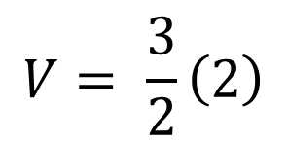
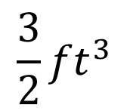
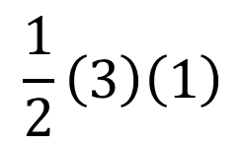
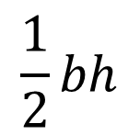
Volume of a Triangular Prism
$$Volume=Bh$$
Area of Base:
$$\frac{1}{2}bh$$
$$\frac{1}{2}\left(3\right)\left(1\right)$$
$$V= \frac{3}{2}\left(2\right)$$
$$\frac{3}{2}{ft}^{3}$$
$$V=3{ft}^{3}$$

Slide 6
Cavalieri’s Principle
If two solids have the same height and the same cross-sectional area at every level, then they have the same Volume

Slide 7
Volume of an Oblique Cylinder
$$Volume=Bh$$
Area of the Base: $πr^{2}$
$$= π({5)}^{2}$$
$$Volume= π{\left(5\right)}^{2}\left(8\right)$$
$$=628.32 {in}^{3}$$

Slide 8
Volume of a Composite Solid
Volume of Half Cylinder + Volume of Cube
Half Cylinder
$$Volume= \frac{1}{2}π{\left(2\right)}^{2}∙4=25.13{in}^{3}$$
Cube
+
$$Volume= 4^{3}=64{in}^{3}$$
$$89.13{in}^{3}$$

