Slide 1
Standard: G.GMD.1
Give an informal argument for the formulas for the circumference of a circle, area of a circle, volume of a cylinder, pyramid, and cone. Use dissection arguments, Cavalieri’s principle, and informal limit arguments

Slide 4
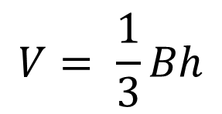
Practice 1
Find the volume of the solid
$$V= \frac{1}{3}Bh$$
$$V= \frac{1}{3}\left(\frac{1}{2}∙4∙6\right)∙9$$
$$V=36m^{3}$$
Triangular Pyramid

Slide 5
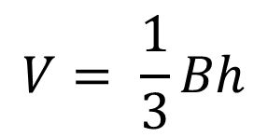
$$V= \frac{1}{3}Bh$$
$$V= \frac{1}{3}\left(π∙{2.2}^{2}\right)4.5$$
$$V=7.26π$$
$$≈22.81 {cm}^{3}$$

Slide 6
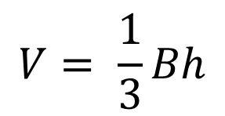
Practice 2
Originally, the pyramid had height 144 meters
And volume 2,226,450 cubic meters.
Find the side length of the square base
$$V= \frac{1}{3}Bh$$
$$2,226,450= \frac{1}{3}\left(x^{2}\right)(144)$$
Substitute what
We know.
x
x
$$6,679,350=144x^{2}$$
Multiply both
Sides by 3
$$46,384= x^{2}$$
Divide each side
By 144
$$215≈x$$
Take the square root of both sides

Slide 7
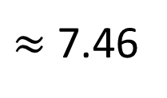
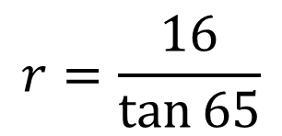
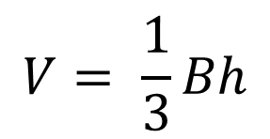
Practice 3
Use Trigonometry to find the Volume of a cone
Find the volume of the right cone.
$$V= \frac{1}{3}Bh$$
$$V= \frac{1}{3}\left(π∙r^{2}\right)∙h$$
1st. We need to find the Radius of the Base.
Use Trigonometry.
$$Tan 65= \frac{Opp}{Adj}=\frac{16}{r}$$
$$r=\frac{16}{\tan{65}}$$
$≈$ 7.46
Now, Substitute the radius
Into the formula for volume
$$V= \frac{1}{3}\left(π∙r^{2}\right)∙h$$
$$V= \frac{1}{3}\left(π∙{7.46}^{2}\right)∙16$$
$$≈932.45 {ft}^{3}$$

Slide 8
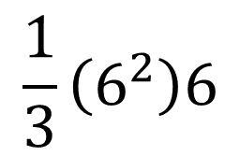
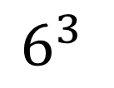
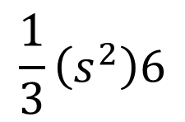
Practice 4
Find the volume of the composite solid
=
+
$$\frac{1}{3}\left(s^{2}\right)6$$
$$s^{3}$$
=
+
$$\frac{1}{3}\left(6^{2}\right)6$$
$$6^{3 }$$
=
216
+
72
=
288m³

Slide 9
Homework
Page 832: # 3, 6, 9, 10, 13, 17, 24

